Slide 1



Samsung SSD 850 PRO 128GB
Cost Analyze
2014/Aug/12
LiteON IT/SSD BU/NVM Central Lab

Slide 2
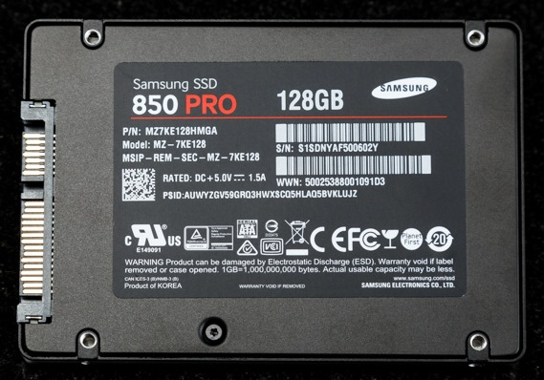
Summary
Product under analysis
Samsung SSD 850 PRO 128GB
Report coverage
BOM analysis
FLASH decap analysis
3D V-NAND TEM analysis
Line1 for Bit line direction
Line2 for Word line direction
Estimated cell layout

Slide 3
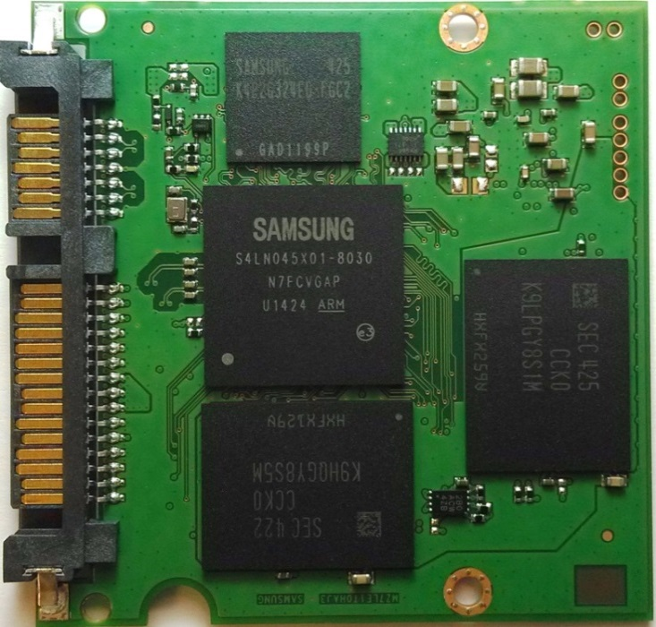
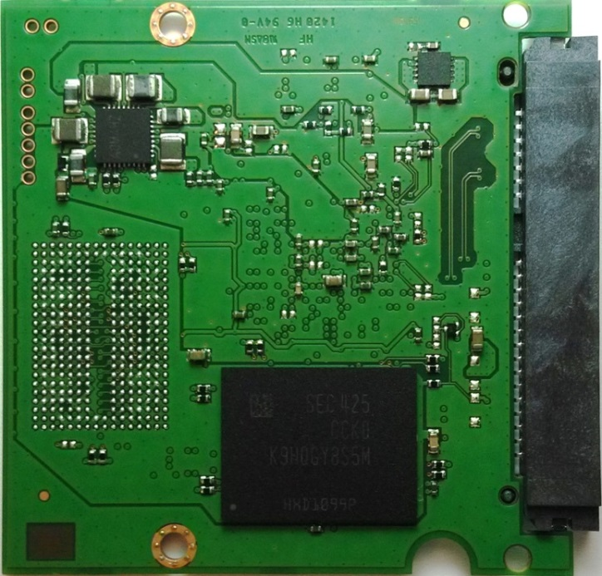
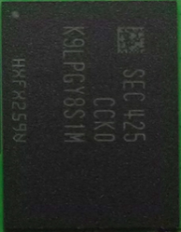
Samsung SSD 850 PRO 128GB-BOM
Bill of Material - Component Count
 | Count | MFG | Part # | Package
FLASH 3D V-NAND MLC, DDP | 2 | Samsung | K9LPGY8S1M | 316-FBGA
FLASH 3D V-NAND MLC, QDP | 2 | Samsung | K9HQGY8S5M | 316-FBGA
MDX controller 3-core ARM-Cortex-R4 supports SATA 6Gb/s | 1 | Samsung | S4LN045X01-8030 | FBGA
DRAM: LPDDR 2Gb, 1CHx32 | 1 | Samsung | K4P2G324ED-FGC2 | 168-FBGA, 12x12
SATA Interface Connector | 1 | Unknow | Unknow | std
Power Management IC for SSD | 1 | NA | AOM4HZ | 32-VQFN 5x5
LOAD SWITCH | 1 | TI | TPS22966 (RB966) | 14-SON
power supervisor / charge pump? | 1 | NA | 2BO ACW 4ZB | SOIC 8pin
Unknow IC | 1 | NA | JS4IAD | 10-SON
Unknow IC | 1 | NA | HMR | SOT25
Crystal | 1 | NA | L.T | NA
Capacitor(0402) | 51 | NA | NA | 0402
Capacitor(0603) | 25 | NA | NA | 0603
Capacitor(0805) | 2 | NA | NA | 0805
Resistor(0402) | 41 | NA | NA | 0402
Diode | 2 | NA | NA | 0402
BAED | 6 | NA | NA | 0805
Total component | 140
53mm
53mm

Slide 4
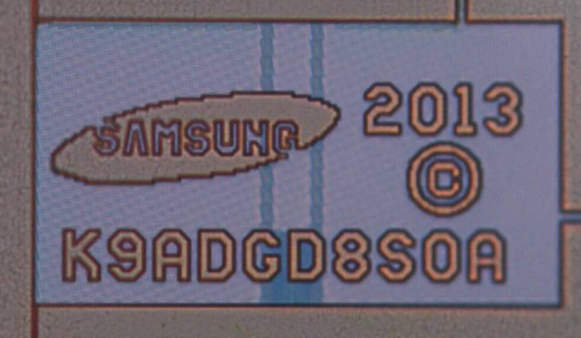
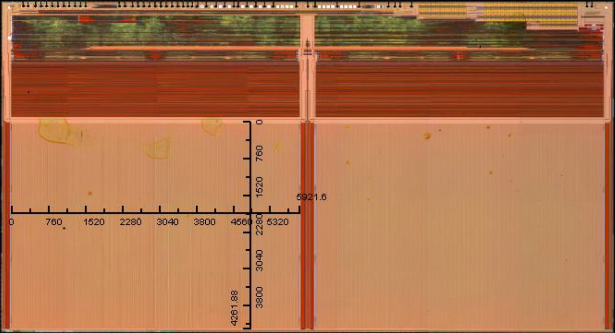
3D V-NAND Decap Analysis
Die Size (mm²) W/O Scribe Line | 12.497*6.739
Die Size (mm²) W/ Scribe Line | 12.567*6.809
Array size (mm²) | 5.922 * 4.262*2
Array Efficiency | 59.94%
Plane/Die | 2
Capacity/Die | 86Gbit
128GB Configuration | DDP*2+QDP*2
Total Die in 128GB | 12 dice
over position | 0.781%
Line 2
Line1 & Line2 are TEM cross section sample position
Line 1

Slide 5
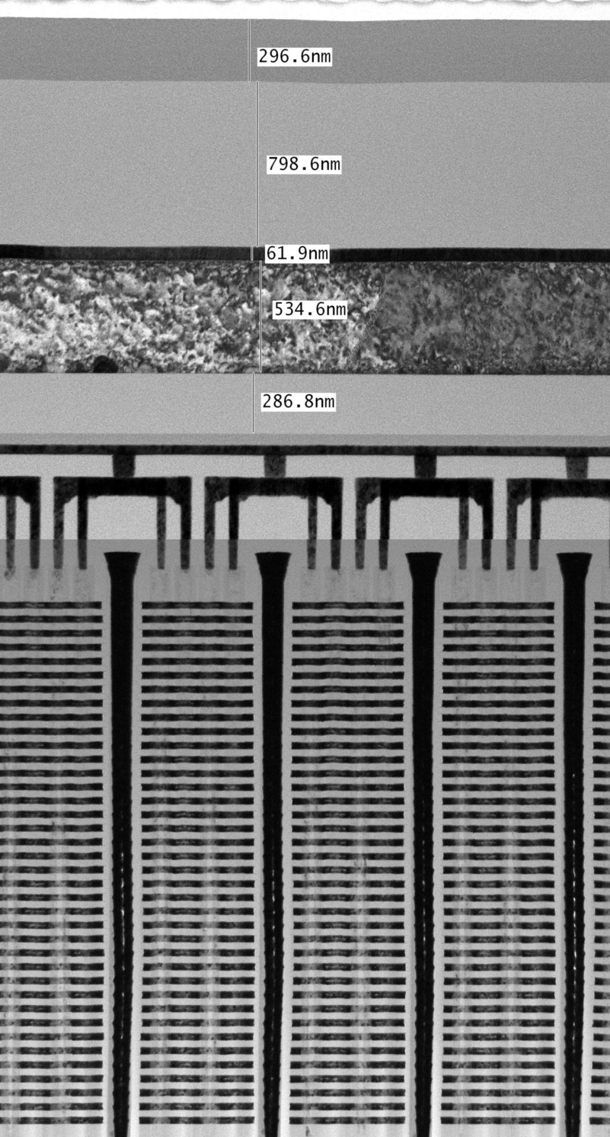
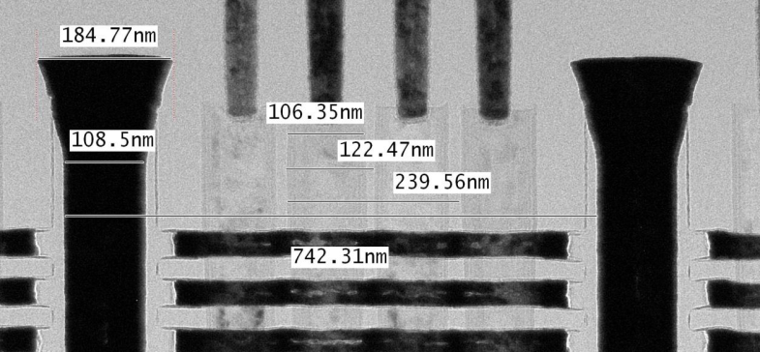
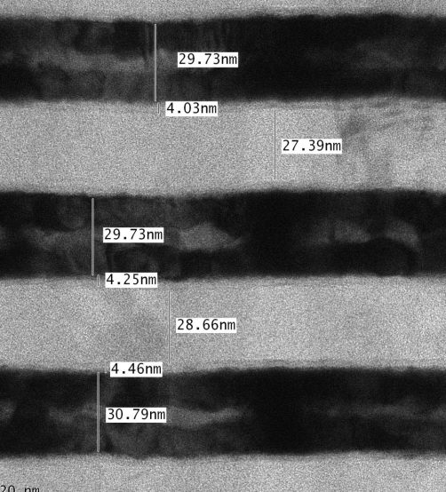
TEM Cross Section: Line 1
Total 38 layers
32 wordlines
4 dummy wordlines
1 select transistor on top
1 select transistor on bottom
Feature size:
Poly pillar diameter:
106.35nm(top) / 75.2nm(bottom)
Poly pillar depth / AR: 2894.5nm / 26
Poly pillar pitch: 239.56 (max)
Layer thickness: WL/Oxide=30 nm / 28nm = 58nm
以DRAM製程經驗，有潛力可以做到50以上
因為WL平面切得很細(僅隔4根柱子就切開)，所以WL厚度不需要太厚

Slide 6
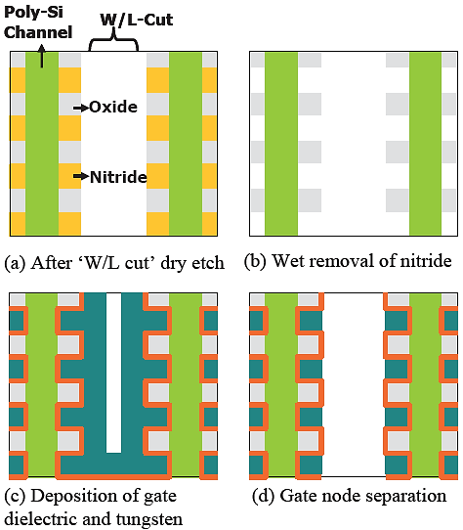
因為WL平面切得很細(僅隔4根柱子就切開)，所以WL厚度不需要太厚
鍍鎢金屬時氣體流進word line平面不用跑太遠，所以厚度30nm已足夠
此頁是註解

Slide 7
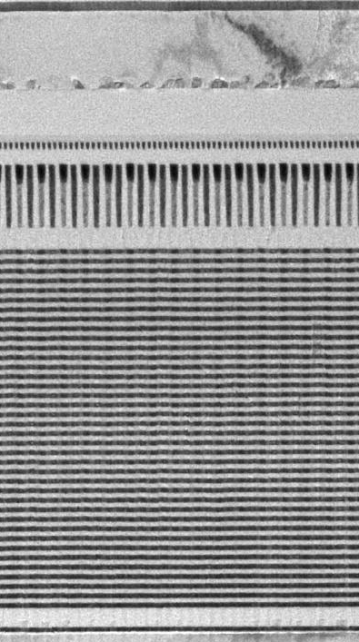
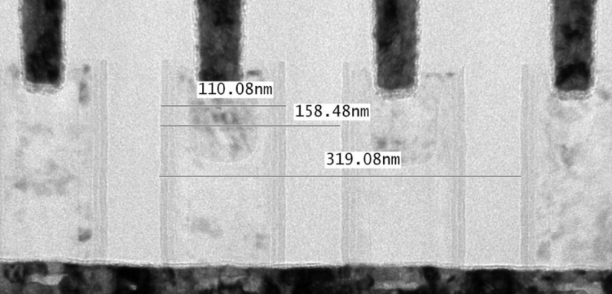
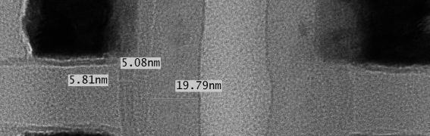
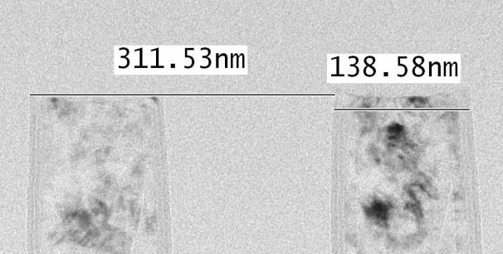
TEM Cross Section: Line 2
Shared WL plane
Feature size:
Poly pillar diameter: 110.08nm (max)
Poly pillar pitch: 319.08 (max)
柱狀邊牆 (Channel poly / Tunneling Oxide / Nitride):
19.79nm / 5.08nm / 5.81nm
Charge Trap Nitride
Channel Poly
Tunnel Oxide
Filling Oxide (單純填充而已)

Slide 8
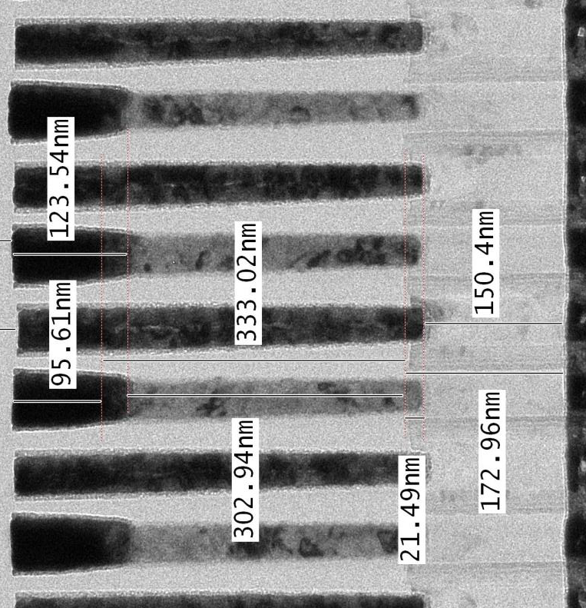
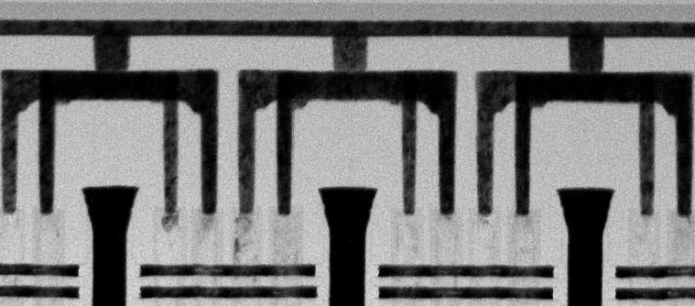
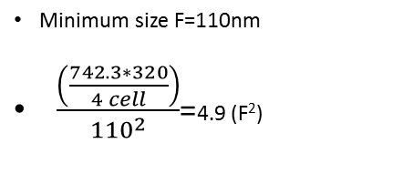
WL plane
Poly Pillar
Line 2
SL
Line 2
742.31nm
320nm
BL
Line 1
BL
Line 1
Minimum size F=110nm
$\frac{\left(\frac{742.3∗320}{4 cell}\right)}{{110}^{2}}$=4.9 (F²)
210nm
110nm
130nm

Slide 9
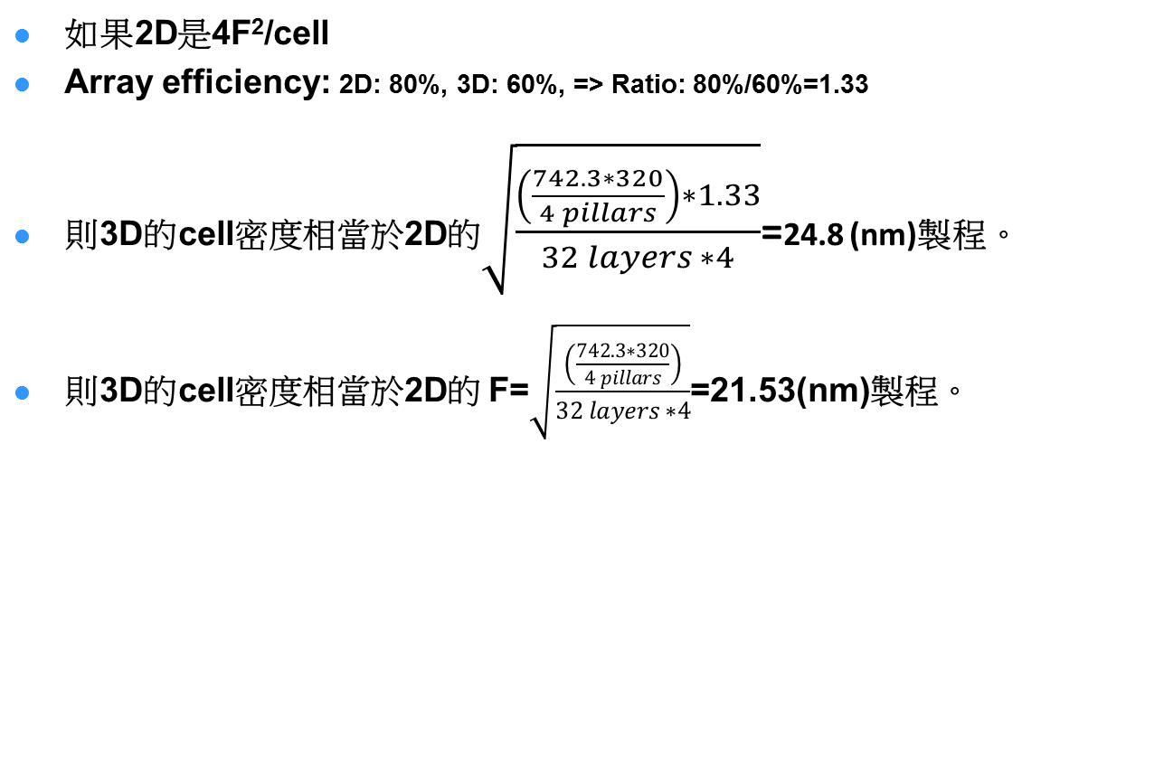
如果2D是4F²/cell
Array efficiency: 2D: 80%, 3D: 60%, => Ratio: 80%/60%=1.33
則3D的cell密度相當於2D的$\sqrt{\frac{\left(\frac{742.3∗320}{4 pillars}\right)∗1.33}{32 layers ∗4}}$=24.8 (nm)製程。
則3D的cell密度相當於2D的 F=$\sqrt{\frac{\left(\frac{742.3∗320}{4 pillars}\right)}{32 layers ∗4}}$=21.53(nm)製程。
Layer # | 2D process
32 | 24.8
48 | 17.6
64 | 15.2
96 | 12.4

Slide 10
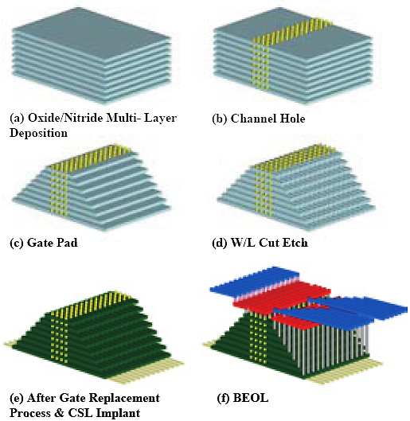
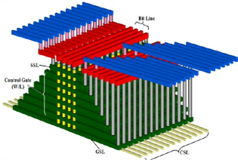
TCAT – Fabrication Process
Line 2
Line 1

